Slide 1
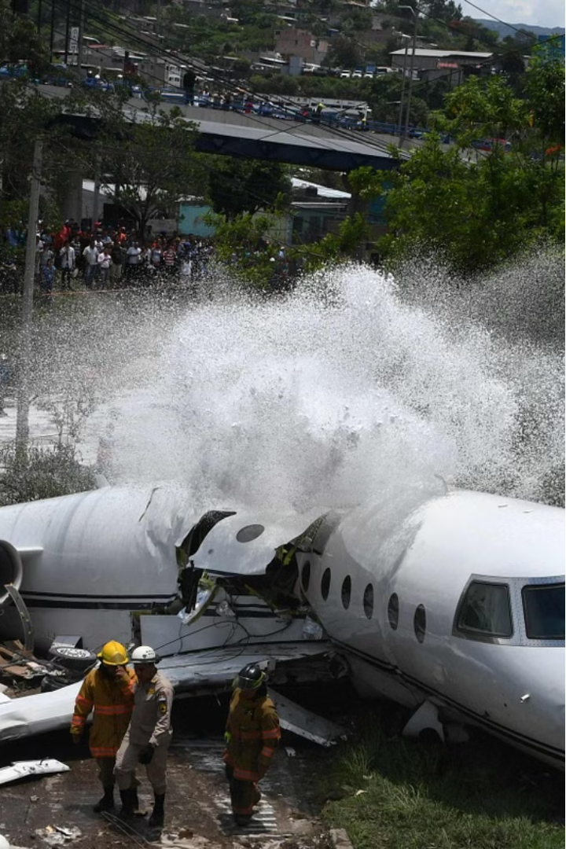



Airplane Crash Analysis
Analyzing airplane crashes is a critical process to improve aviation safety. By understanding the common causes and patterns of crashes, we can develop more effective prevention strategies and enhance the overall safety of air travel.
by kalpesh jadhav
Mentorness Internship Batch: MIP-DA-06

Slide 2
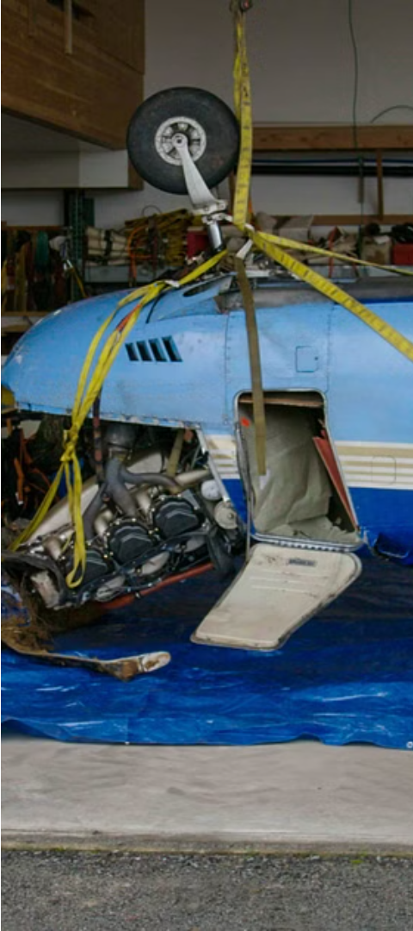
Importance of Crash Investigation
1
Prevent Future Accidents
2
Improve Design and Procedures
Investigating crashes helps identify safety issues and implement solutions to prevent similar incidents from happening again.
Crash analysis leads to improvements in aircraft design, maintenance protocols, and pilot training to enhance safety.
3
Provide Closure for Victims
Investigating the causes of a crash provides answers and closure for the families of those involved.

Slide 3
Content
Problem Statement
Objective
Data Cleaning
Dashboard
Common Causes of Airplane Crashes
Recommendations for Improved Safety
Case Studies and Lessons Learned
Conclusion and Future Considerations
Summary

Slide 4
Problem Statement
This internship project focuses on conducting a comprehensive analysis of airplane crashes and fatalities
spanning from 1980 to 2023. The dataset contains crucial information such as crash dates, locations,
operators, flight details, aircraft types, and fatality statistics. The goal is to leverage Power BI for
interactive visualizations and in-depth insights to understand patterns, contributing factors, and trends in
aviation incidents. The analysis aims to provide stakeholders with valuable information for enhancing
aviation safety and mitigating risks.

Slide 5
Project Objective
*Temporal Analysis:
Explore temporal trends in airplane crashes over the years.
Identify patterns in the frequency and severity of incidents.
*Geospatial Analysis:
Visualize crash locations on a map to identify hotspots.
Analyse the distribution of incidents across different regions.
*Operator Performance:
Evaluate the safety records of different operators and airlines.
Identify operators with higher incident rates.
*Aircraft Analysis:
Analyse the involvement of specific aircraft types in incidents.
Examine the relationship between aircraft registration and crash occurrences.
*Fatality Trends:
Explore trends in passenger and crew fatalities.
Investigate factors contributing to fatalities.
*Route Analysis:
Analyse incident patterns on specific flight routes.
Identify routes with a higher likelihood of incidents.

Slide 6
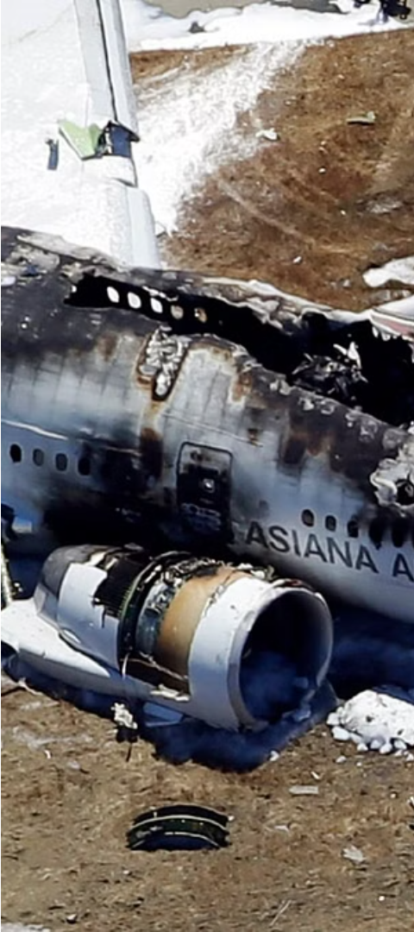
Data Collection and Data Cleaning Analysis
1
Gather Evidence
Collect data from the crash site, including flight recorders, Operators ,Fatality, Grounded.
2
Data Cleaning
The data cleaning process involved addressing missing values and ensuring the data accuracy. additionally Region, Country and Category columns are added to give important information from the dataset.
Analyzing the data helps piece together the sequence of events leading up to the crash.
3
Identify Causal Factors
The investigation focuses on determining the root causes and contributing factors that led to the accident.

Slide 7
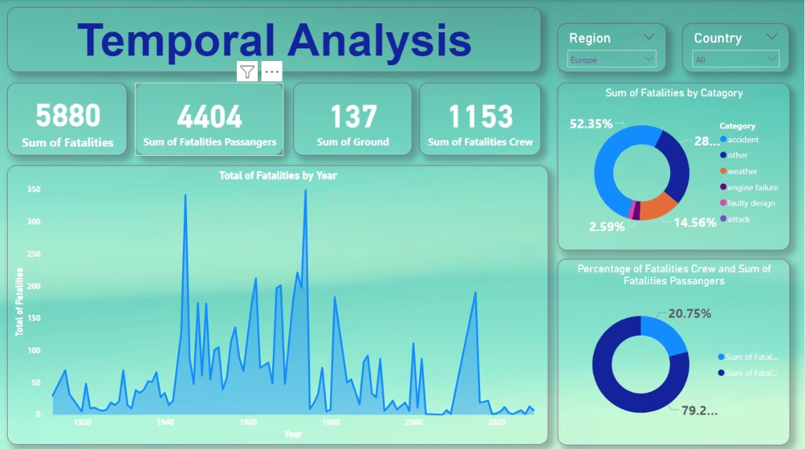

Slide 8
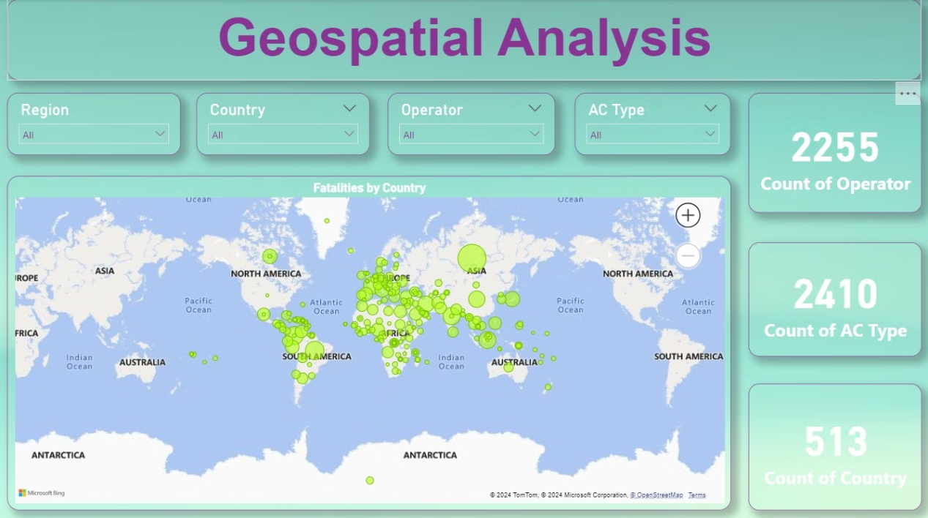

Slide 9
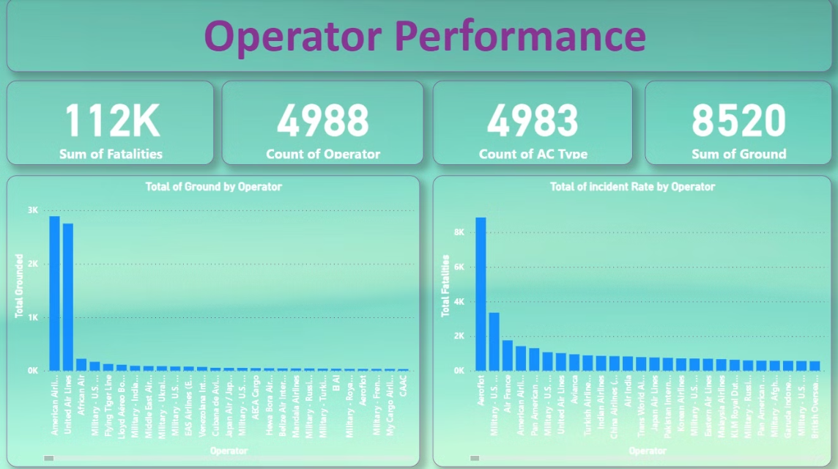

Slide 10
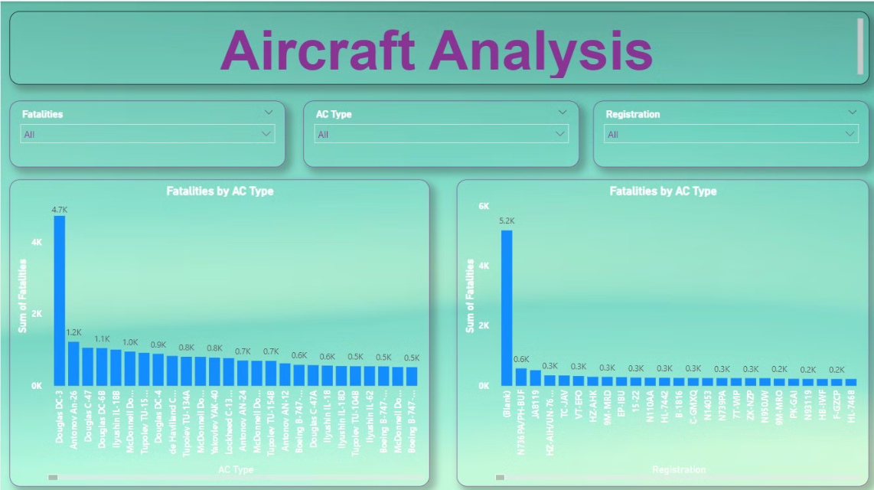

Slide 11
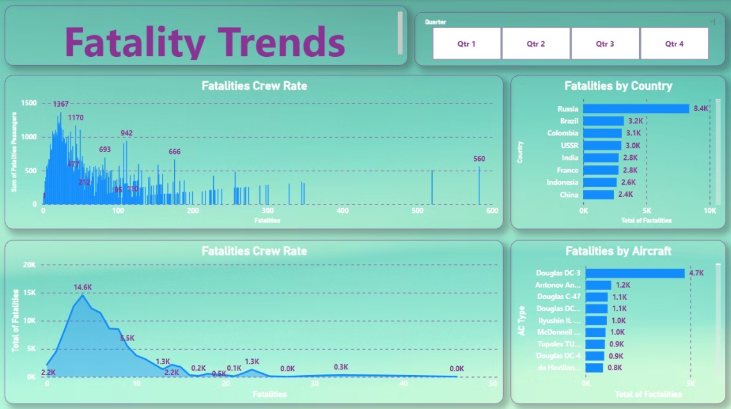

Slide 12
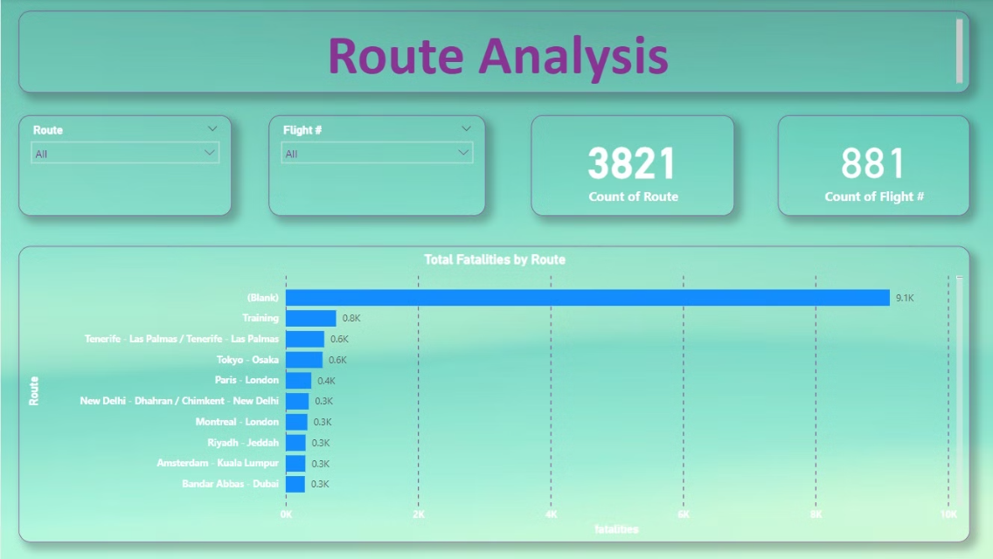

Slide 13
Common Causes of Airplane Crashes
Human Error
Mechanical Failures
Environmental Factors
Pilot errors, such as poor decision making, lack of training, or fatigue, are a leading cause of crashes.
Issues with aircraft design, manufacturing defects, or lack of maintenance can result in critical equipment malfunctions.
Weather conditions, such as severe storms, icing, or turbulence, can overwhelm the aircraft's capabilities.

Slide 14




Recommendations for Improved Safety
Enhanced Regulations
Updating and enforcing stricter safety regulations can address identified vulnerabilities.
Improved Pilot Training
Enhancing pilot education and simulation-based training can better prepare crews for emergencies.
Technological Advancements
Implementing new technologies, such as predictive analytics and autonomous systems, can enhance aircraft safety.

Slide 15




Case Studies and Lessons Learned
Flight Data Recorders
Improved Weather Monitoring
Rigorous Maintenance
Simulator-based Training
Crucial in understanding the sequence of events leading to crashes.
Proactive and comprehensive maintenance programs can prevent mechanical failures.
Enhancing weather forecasting and real-time monitoring helps pilots avoid hazardous conditions.
Preparing pilots for rare but critical scenarios improves their decision-making skills.

Slide 16
Conclusion and Future Considerations
Continuous Improvement
Crash investigations must drive ongoing enhancements to aviation safety.
Emerging Technologies
Advancements in AI, automation, and communication can revolutionize aircraft safety.
Collaboration and Transparency
Sharing findings and best practices globally can accelerate safety improvements.

Slide 17
Summary
The project of airplane crashes and fatalities spanning 1980 to 2023 with the primary aim of levering insights to enhance aviation safety and mitigate risk. the dataset encompasses crucial details such as crash dates , crash location, operators, flight type, aircraft type, and fatality statics. using PowerBI we delve into temporal trends , incident severity, and fatalities through interactive visualization, we dissect geospatial patterns, route , operator, specific aircraft type .our data cleaning process ensure accuracy and consistency , we endeavor to provide stakeholders with actionable information for proactively enhancing aviation safety standards, ultimately contributing to a safer air travel environment.

